Slide 1
Linear
Cartesian planes and linear relationships

Slide 2
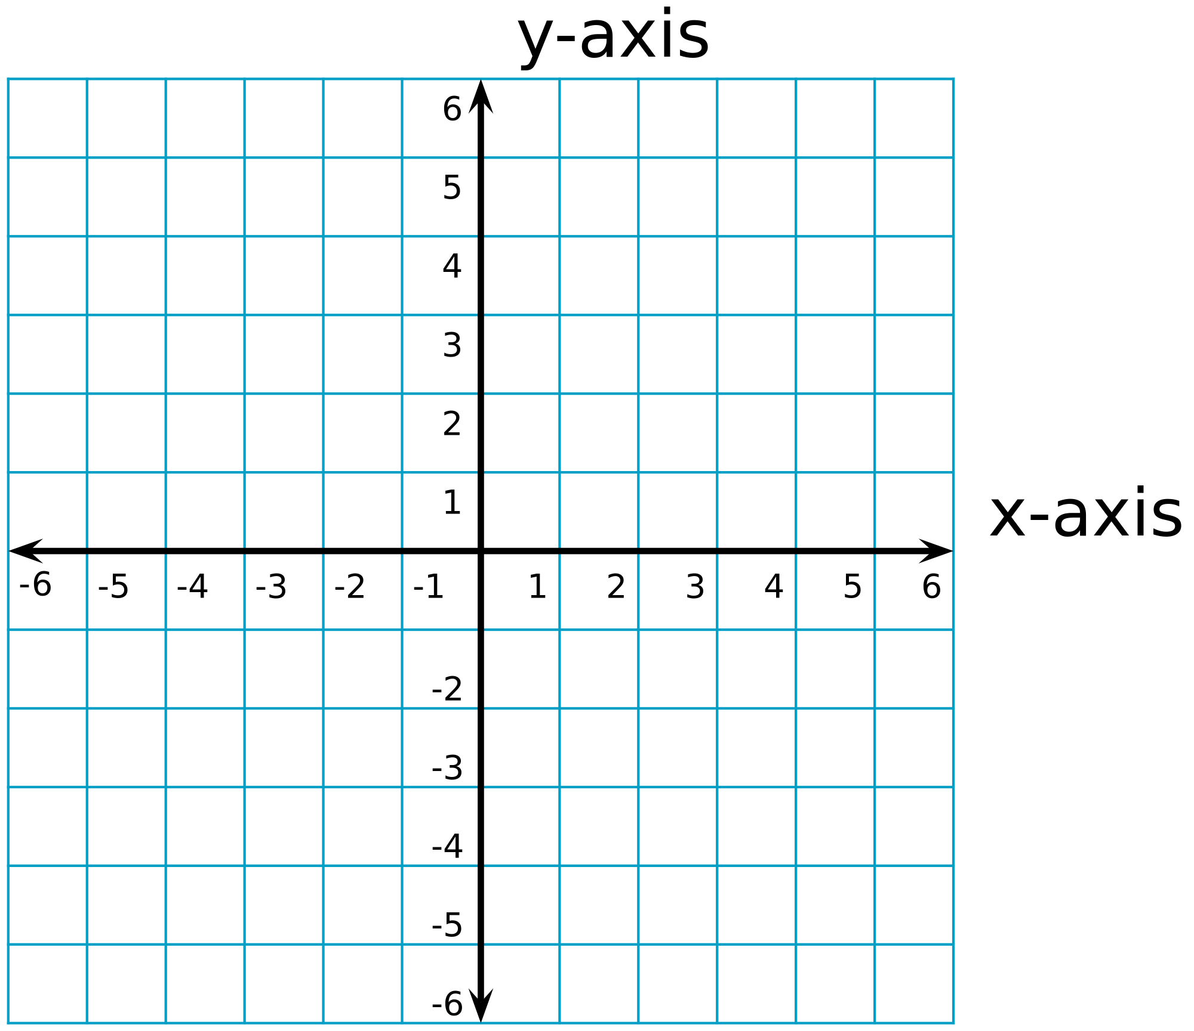
Cartesian Plane

Slide 3
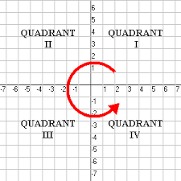
Quadrants

Slide 4
(0,2) → first number is on the x-axis, second number is on the y-axis

Slide 5
(4,3) → first number is on the x-axis, second number is on the y-axis

Slide 6
(-3, 5) → first number is on the x-axis, second number is on the y-axis

Slide 7
(-3, -5) → first number is on the x-axis, second number is on the y-axis

Slide 8
Linear Relationships
A linear graph is a straight line graph that shows the relationship between two variables. It can be drawn if the know the rule (e.g. y= x + 2) that connects the two variables. This rule shows a linear relationship.
The rule or equation is used to complete a table of values that shows the x and y coordinates of some points on the line. These are plotted on the Cartesian plane and connected with a line.
Any point on the line can be represented by coordinates, an x coordinate and a y coordinate. These coordinates are written as an ordered pair (x,y)
The ordered pair (0,0) is known as the origin

Slide 9
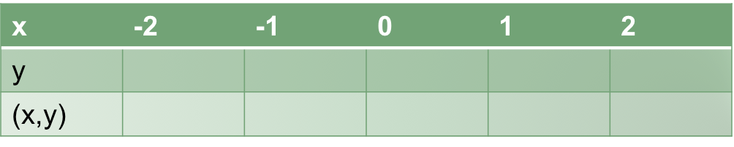
Example
Complete the following table of values for the rule y=x/2 +4 for the values of x in the range -2 to 2

Slide 10
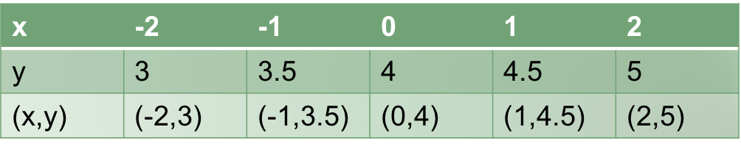
Draw your graph from the table

Slide 11
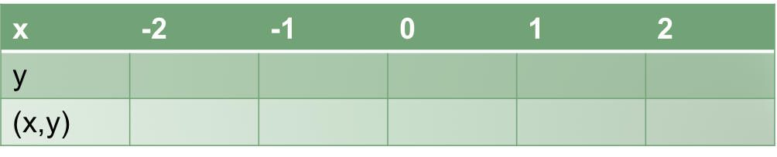
You Try...
Complete a table of values for the rule y= x + 1 for the values of x in the range -2 to 2.
Graph once you have completed the table

Slide 12
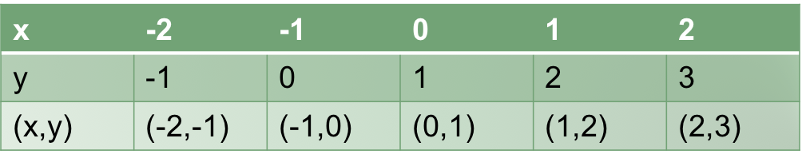
You Try... answers
Complete a table of values for the rule y= x + 1 for the values of x in the range -2 to 2.
Graph once you have completed the table

Slide 13
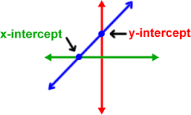
X and Y intercepts
The x intercept of the graph is the point where the line crosses the x axis
The y intercept of the graph is the point where the line crosses the y axis

Slide 14
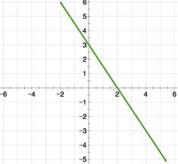
You try…
Give the coordinates of the x and y intercepts
X intercept: 2 (2,0)
Y intercept: 3 (0,3)

Slide 15
Gradient
The gradient tells us about the line of the slope.
This line has a positive gradient as it slopes upwards from left to right
This line has a negative gradient as it slopes downwards from left to right
Line with the same gradient are parallel

Slide 16
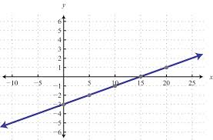
You try…
(a) state the x intercept and write the coordinates of the point
(b) state the y intercept and write the coordinates of the point
(c) state whether the gradient of the line is positive or negative

Slide 17
You try… answers
(a) state the x intercept and write the coordinates of the point 15 (15,0)
(b) state the y intercept and write the coordinates of the point -3 (0,-3)
(c) state whether the gradient of the line is positive or negative positive

Slide 18
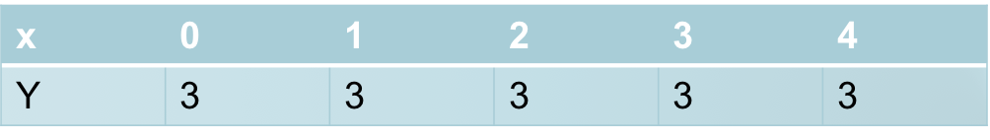
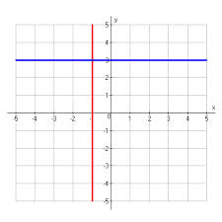
Special Gradients
Below is the table with the values for the equation y = 0x + 3 (or y=3)
The equation produces a horizontal line (blue). It never crosses the x axis

Slide 19
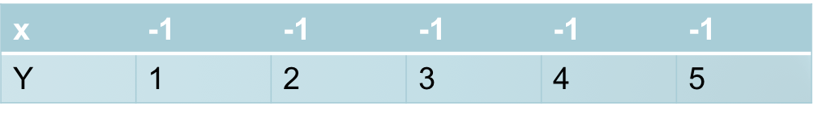
Special Gradients
Below is the table with the values for the equation x = -1
The equation produces a vertical line (red). It never crosses the y axis

Slide 20
A horizontal line has a gradient of zero
A vertical line has a gradient that cannot be defined. We say the gradient is undefined

Slide 21
Example
Max has 10 litres of fuel left in his car’s petrol tank. When he fills it at the petrol station, petrol runs into the tank at 15 litres per minute. The petrol tank can hold 70L.
(a) identify the independent and dependent variables
(b) make a table of values for the number of litres of petrol in the tank after time t minutes and plot the graph of L against t
(c) is the relationship between L and t linear?
(d) is it sensible to going the points of the graph with a straight line?
(e) For every time increase of 1 minute, what is the change in L?
(f) Find the number of litres of petrol in the tank after 1.5 minutes
(g) at what time will there be 50L of petrol in the tank?

Slide 22
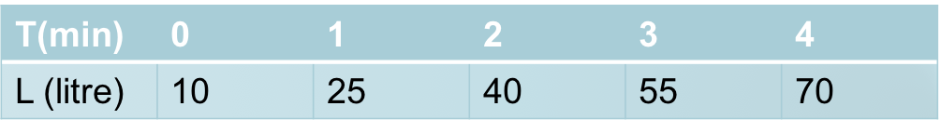
You try…
Max has 10 litres of fuel left in his car’s petrol tank. When he fills it at the petrol station, petrol runs into the tank at 15 litres per minute. The petrol tank can hold 70L.
(a) identify the independent and dependent variables
the number of litres depends on the time taken to fill so independent is time and dependent is litres of petrol
(b) make a table of values for the number of litres of petrol in the tank after time t minutes and plot the graph of L against t

Slide 23
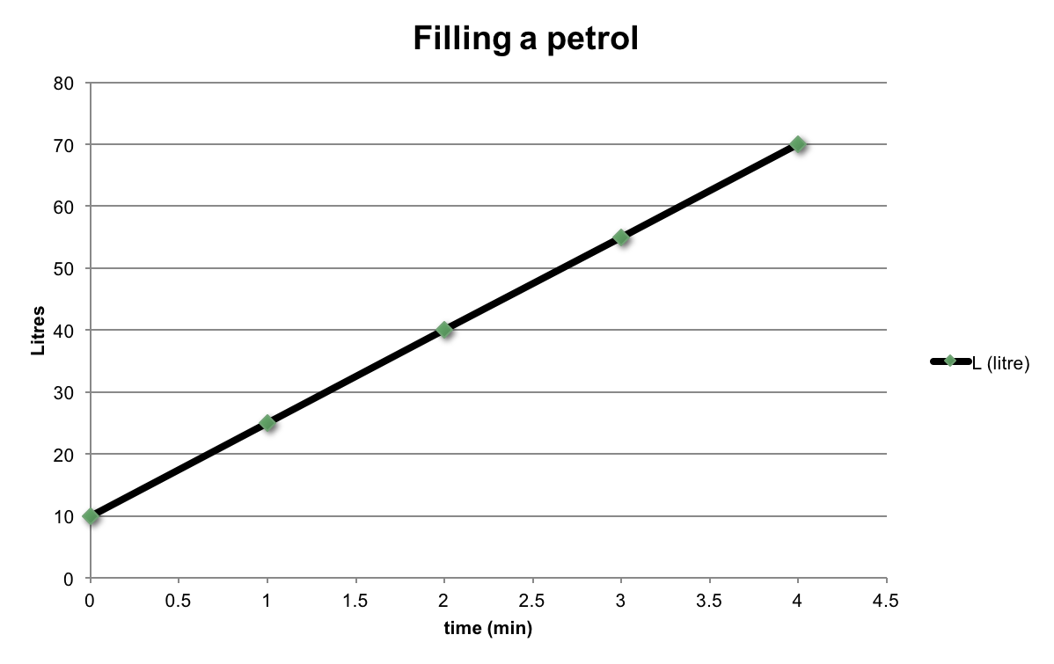
(c) is the relationship between L and t linear?

Slide 24
(d) is it sensible to going the points of the graph with a straight line? Yes, as Max could add petrol for 2.5mins
(e) For every time increase of 1 minute, what is the change in L? for every time increase of 1 minute, L increases by 15L
(f) Find the number of litres of petrol in the tank after 1.5 minutes after 1.5 minutes, there are 32.5L of petrol in the tank
(g) at what time will there be 50L of petrol in the tank? There are 50 litres in the tank after about 2.7minutes

Slide 25
You Try…
Each week a department store employee receives a basic salary of $300. In addition, she is paid a bonus of $20 for each new member she signs up to the store’s rewards clubs. Let l be the employee’s income and m be the number of members she signed up to the rewards club.
(a) what are the independent and dependent variables?
(b) Construct a table and draw a graph of income I against members m where m = 0, 1, 2, 3, …, 10.
(c) is the relationship linear?
(d) is it sensible to join the points with a straight line?
(e) For each new member signed, what is the employee’s increase income?

Slide 26
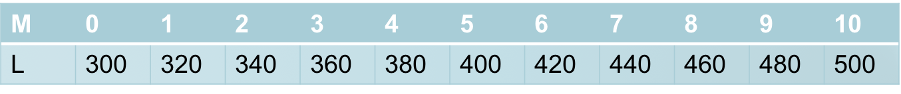
Each week a department store employee receives a basic salary of $300. In addition, she is paid a bonus of $20 for each new member she signs up to the store’s rewards clubs. Let l be the employee’s income and m be the number of members she signed up to the rewards club.
(a) what are the independent and dependent variables? m is the independent variable. I is the dependent variable
(b) Construct a table and draw a graph of income I against members m where m = 0, 1, 2, 3, …, 10.

Slide 27
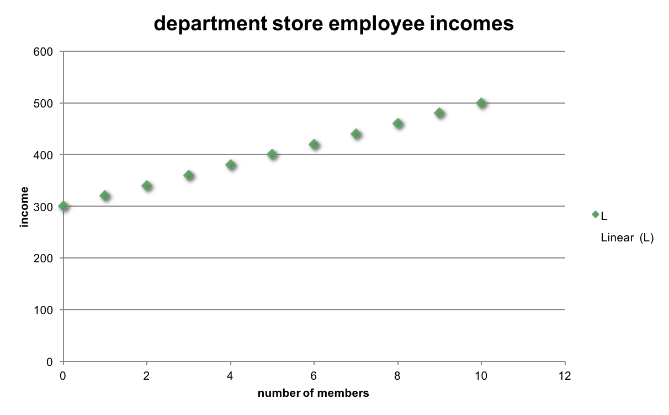

Slide 28
(c) is the relationship linear? yes
(d) is it sensible to join the points with a straight line? No as we cant have half members
(e) For each new member signed, what is the employee’s increase income? $20

